Slide 1


Decision Making / Branching

Slide 2
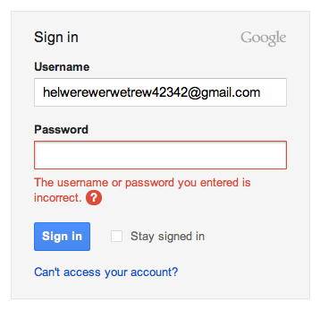
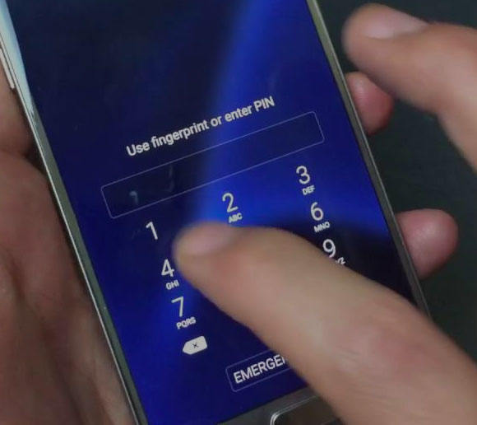
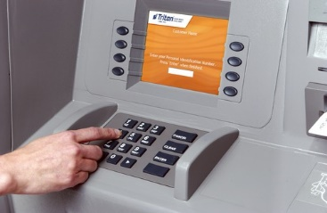
Where we are using Decision Making?
Decision making is about deciding the order of execution of statements based on certain conditions

Slide 3
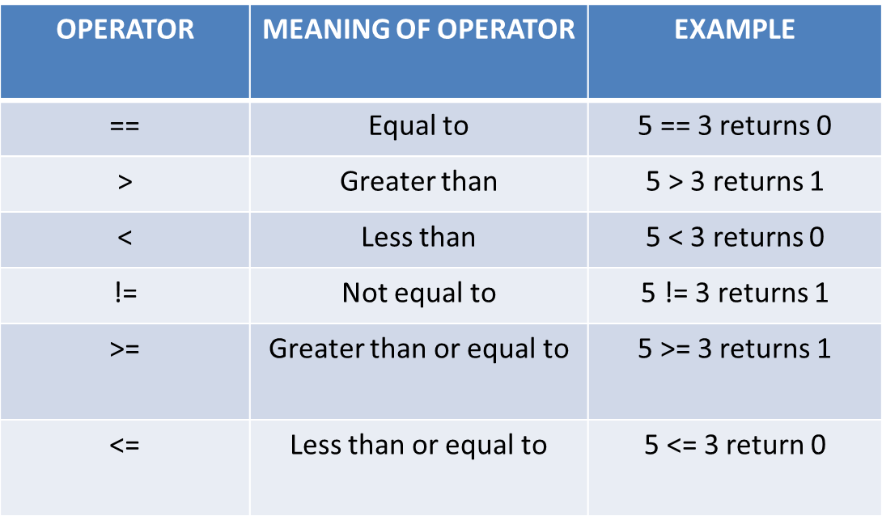
Decision making using Conditions
Conditions are formed by relational operators.

Slide 4
Types
If (simple if)
if – else
Cascaded(if else - if)
Nested if
Switch case

Slide 5
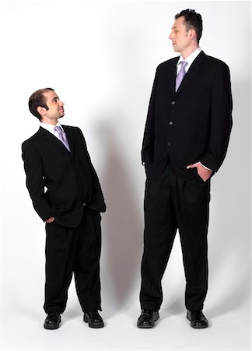
Who is taller?
How will you find it?
By comparing
How to do that in programming?
Using relational operators
Notes:
Title + Image + Text

Slide 6
if statement
Syntax :
if(condition)
{
// Statements inside.
}
//remaining statements
//statement outside
If the expression or condition returns true, then the statements-inside will be executed, otherwise statements-inside will be skipped

Slide 7
Code
1
2
3
4
5
6
7
#include<stdio.h>
int main()
{
int h1, h2;
scanf(“%d”, &h1);
scanf(“%d”, &h2);
if( h1 > h2) //checks for condtion
{
printf(“Person 1 is taller”); //executes if true
}
if( h2 > h1) //checks for condtion
{
printf(“Person 2 is taller”); //executes if true
}
}

Slide 8
Assignment Questions
Write the Program to find maximum of two numbers using simple if.
What is the output of the following
if(1)
{
print(“True”);
}

Slide 9
if – else statement
Syntax:
if(condition)
{
//block1: code to be executed if condition is true
}
else
{
//block2: code to be executed if condition is false
}
If the expression is true, the statement-block1 is executed, else statement-block1 is skipped and statement-block2 is executed..

Slide 10
Code
1
2
3
4
5
6
7
8
9
10
11
12
13
14
#include<stdio.h>
int main()
{
int h1, h2;
scanf(“%d”, &h1);
scanf(“%d”, &h2);
if( h1 > h2)
{
printf(“Person 1 is taller”);
}
else{
printf(“Person 2 is taller”);
}
}

Slide 11

Which one of the following condition(s) has to be satisfied to check if a person is eligible to donate blood?
A) Age > 18
B) Weight > 50
C) Both A and B
How will you write this in programming?
Using logical operators

Slide 12
Logical operators
Operators | Meaning
&& | AND
|| | OR
! | NOT

Slide 13
How to use logical operators in program?
if(age > 18) && (weight > 50 )
{
print(“Eligible to donate blood”)
}
else
{
printf(“Not eligible”)
}
Notes:
Title + Image + Text

Slide 14
Code
1
2
3
4
5
6
7
8
9
10
11
12
13
14
#include<stdio.h>
int main()
{
int age, weight;
scanf(“%d”, &age);
scanf(“%d”, &weight);
if(( age > 18) && (weight > 50))
{
printf(“Eligible to donate blood”);
}
else{
printf(“Not eligible”);
}
}

Slide 15

Who is taller?
How will you find it?
By comparing
How to do that in programming?

Slide 16
Cascaded(if else-if ladder)
Syntax:
if(condition1)
{
//block1: code to be executed if condition1 is true
}
else if(condition2)
{
//block2:code to be executed if condition2 is true
}
else if(condition3){
//block3:code to be executed if condition3 is true
}
...
else{
//:code to be executed if all the conditions are false
}
The if...else ladder allows you to check between multiple test expressions and execute different statements..

Slide 17


Decision Making in PUBG
PUBG players are not going to get a Chicken Dinner anytime soon without the ability to aim at targets and take them down with relative ease. So to aim the target they must use scope. It can take hundreds of rounds before you become more comfortable with all the weapons on offer and start landing your shots, but we’re here to help speed that process up.
Conditions:
If you have 8x scope, Use snipper gun.
If you have 6X scope, Use AUG A3, GROZA, QBZ, M16A4, M416 .
If you have 4x Scope, Use UMP9, AKM, SCAR-L, Cross Bow .
If you have 2x Scope, almost all guns.
If you don’t have scope, find one.
Now Let’s help them by writing a program which helps them
to select the gun based on the scope .

Slide 18
Pseudocode
if(scope == 8)
{
Print(“Use Snipper”);
}
else if(scope == 6)
{
Print(“Use AUG A3 / GROZA / QBZ / M16A4 / M416 “);
}
else if(scope == 4)
{
Print(“Use UMP9 / AKM / SCAR-L / Cross Bow );
}
else if(scope == 2)
{
Print(“Almost all guns”);
}
else
{
Print(“Find one”);
}
Notes:
Title + Image + Text

Slide 19
Code
1
2
3
4
5
6
7
8
9
10
11
12
13
14
#include<stdio.h>
int main()
{
int scope;
scanf(“%d”, &scope);
if(scope == 8)
{
printf(“Use Snipper”);
}
else if(scope == 6){
printf(“Use AUG A3 / GROZA / QBZ / M16A4 / M416 “);
}

Slide 20
Code
15
16
17
18
19
20
21
22
23
24
25
26
27
14
else if(scope == 4)
{
printf(“Use UMP9 / AKM / SCAR-L / Cross Bow ”);
}
else if(scope == 2)(
printf(“Almost all guns”);
}
else{
printf(“Find one”);
}
}

Slide 21
Assignment Questions
Write a C program to find maximum between three numbers using if else if ladder.
Input
Input num1: 10
Input num2: 20
Input num3: 15
Output
Maximum is: 20

Slide 22
//program to find maximum between three numbers using if else if ladder.
#include <stdio.h>
int main() {
int n1, n2, n3;
printf("Enter three numbers: ");
scanf("%lf %lf %lf", &n1, &n2, &n3);
if (n1 >= n2 && n1 >= n3)
printf("%.2lf is the largest number.", n1);
// if n2 is greater than both n1 and n3, n2 is the largest
else if (n2 >= n1 && n2 >= n3)
printf("%.2lf is the largest number.", n2);
// if both above conditions are false, n3 is the largest
else
printf("%.2lf is the largest number.", n3);
return 0;
}

Slide 23
Nested if
Use one if or else if statement inside another if or else if statement(s).
Syntax:
if (condition1)
{
// code to be executed if condition1 is true
if (condition2)
{
// code to be executed if condition2 is true
}
}

Slide 24

Bunjee Jumping
Have you tried or seen Bunjee Jumping ? It’s a weird experience, Isn’t it?.
But if someone is very eager to try bunjee jumping, they must satisfy few conditions
conditions:
Minimum Weight must be 40 kgs
Maximum Weight must be 110 kgs[If
Weight is greater than maximum, extra
ropes will be added]
3) Minimum age required is 12 years.
So if any person satisfying these criteria, Can enjoy
bunjee jumping.
Now we are going to write a program to check whether
the particular person is satisfying these criterias or not.

Slide 25
Pseudocode
If(age >= 12)
{
If(weight >= 40)
{
If(weight <= 110)
{
print(“He can Jump”);
}
else
{
print(“Extra ropes will be added”);
}
}
else
{
print(“He can’t Jump”);
}
}
else
{
Print(“He can’t Jump”);
}
Notes:
Title + Image + Text

Slide 26
Code
1
2
3
4
5
6
7
8
9
10
11
12
13
14
#include<stdio.h>
int main()
{
int age, weight;
scanf(“%d”, &age);
scanf(“%d”, &weight);
if(age >= 12){
if(weight >= 40){
if(weight <= 110){
printf(“He can Jump”);
}
else{
printf(“Extra ropes will be added”);
}

Slide 27
Code
15
16
17
18
19
20
21
22
23
24
25
26
27
28
}
else{
printf(“He can’t Jump”);
}
}
else{
printf(“He can’t Jump”);
}
return 0;
}

Slide 28
Switch Case (Multiple Branching Statement)
The switch statement allows us to execute one code block among many alternatives.
Allows us to execute multiple operations for the different possible values of a single variable called switch variable.
We can define various statements in the multiple cases for the different values of a single variable.
Syntax:
switch(expression){
case 1:
//code to be executed;
break;
case 2:
//code to be executed;
break;
......
default:
code to be executed if all cases are not matched;
}

Slide 29
Switch Case (Multiple Branching Statement)
Rules for switch statement in C language
The switch expression must be of an integer or character type.
The case value must be an integer or character constant.
The case value can be used only inside the switch statement.
The break statement in switch case is not must. It is optional. If there is no break statement found in the case, all the cases will be executed present after the matched case. It is known as fall through the state of C switch statement.

Slide 30
Switch Case Programs:
1) Write a C Program To Read Month Number And Display Month Name Using Switch Case

Slide 31
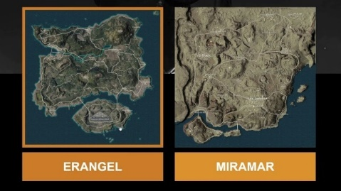


PUBG
Do you know how many maps are there in PUBG ?
Erangel [Forest]
Miramar[Desert]
Sanhok[Rain Forest]
Vikendi[Snow Forest]
When user enters the corresponding number of maps [1, 2, 3, 4].
It must get into that map, show a Welcome message and
displays the type of that map [Forest, Desert, Rain Forest, Snow Forest].
Use Switch Case. Switch case is a multiple-branching statement
Write a program for selection of a map on different maps in pubg
Game using switch statement

Slide 32
Pseudocode
switch(number)
{
case 1:
Print(“Welcome to Erangel Map. You are Inside a Forest”);
break;
case 2:
Print(“Welcome to Miramar Map. You are Inside a Desert”);
break;
case 3:
Print(“Welcome to Sanhok Map. You are Inside a Rain Forest”);
break;
case 4:
Print(“Welcome to Vikendi Map. You are Inside a Snow Forest”);
break;
default:
Print(“Invalid Input”);
}
Notes:
Title + Image + Text

Slide 33
Code
1
2
3
4
5
6
7
8
9
10
11
12
13
14
#include<stdio.h>
int main()
{
int number;
scanf(“%d”, &number);
switch(number){
case 1:
printf(“Welcome to Erangel Map. You are Inside a Forest”);
break;
case 2:
printf(“Welcome to Miramar Map. You are Inside a Desert”);
break;

Slide 34
Code
15
16
17
18
19
20
21
22
23
24
25
26
27
28
case 3:
printf(“Welcome to Sanhok Map. You are Inside a Rain Forest”);
break;
case 4:
printf(“Welcome to Vikendi Map. You are Inside a Snow Forest”);
break;
}
return 0;
}

Slide 35
Switch Case (Fall through)
The break statement in switch case is not must. It is optional. If there is no break statement found in the case, all the cases will be executed present after the matched case. It is known as fall through the state of C switch statement.
Syntax:
switch(expression){
case 1:
case 2:
case 3:
// Code to be executed
break
case 4:
case 5:
case 6:
// Code to be executed
break
}

Slide 36
Pseudocode
Switch(number)
{
case 1:
case 2:
case 3:
case 4:
Print(“1.Selecting an area to drop out. \n2.Looting weapons and equipments.\n3.Stay out of blue circle.\n4.Kill your enemies.”);
break;
}
Notes:
Title + Image + Text

Slide 37
Rules for expression in switch
Valid Expressions:
Constant expressions: 2 + 3, 9 * 16 % 2, 10 / 2 + 5, ‘a’ , ‘a’ + 1 etc.
All these expressions evaluate to Integer constants, so they are valid.
Variable expressions (Assume int a,b; and Char c): a, a – b, c * a – 4,c + 1, etc. int and char are considered integral and valid in switch, and all the expressions evaluate to an integral value, so they are valid.
Invalid Expressions:
Variable expressions (Assume float a; double b;) : a,b, a + 4.5, b * 10 etc. Float and double are invalid datatypes in switch expressions

Slide 38
/*Write a program to use relational, arithmetic and logical operations in Switch //case example */
#include <stdio.h>
int main()
{
int x = 10, y = 5;
switch(x>y && x+y>0)
{
case 1:
printf("hi");
break;
case 0:
printf("bye");
break;
default:
printf(" Hello bye ");
}

Slide 39
Nested switch case statement
A switch statement inside another switch statement.
Such type of statements is called nested switch case statements.
Syntax:
switch(expression1) {
case value1:
statements;
switch(expression2)
{
case value:
inner switch statements;
break;
.
.
}
break;
case value2: /* case code */
}

Slide 40
Nested switch case statement example
You are searching for a department in a university and you’re asked to
Selecting a school from a choice of THREE schools namely:
School of Engineering
School of Business
School of pharmacy
1. School of Engineering
Department of Mechanical Engineering
Department of Civil Engineering
Department of Computer Science Engineering
School of Business
Department of Commerce
Department of purchasing
various departments would then be listed within inner switch statements beneath their respective schools
Write a c program to display dept names for given school using nested switch statement

Slide 41
#include<stdio.h>
int main()
{
int a,b;
printf("1. School of Engineering \n");
printf("2.School of Business\n");
printf("3.School of pharmacey\n");
printf("make your selection\n");
scanf("%d",&a);
switch (a)
{
case 1:
//if school of Engineering is chosen;
printf("Available Departments\n"
printf("1.Department of Mech\n");
printf("2.Department of Civil\n");
printf("2.Department of CSE\n");
printf("Make your selection.\n");
scanf("%d",&b);
//inner switch to display the departments
switch(b)
{
case 1:
printf(" Department of Mech\n" );
break;
case 2:
printf(" Department of Cilvil" );
break;
case 3:
printf(" Department of CSE" );
break;
}
break;
}
case 2:
//code to be executed
//if school of businessis chosen;
break;
}
.
.

Slide 42
Nested switch case statement Example2
#include <stdio.h>
int main () {
int i = 10;
int j = 20;
switch(i) {
case 10:
printf("the value of i evaluated in outer switch: %d\n",i);
case 20:
switch(j) {
case 20:
printf("The value of j evaluated in nested switch: %d\n",j);
}
}
printf("Exact value of i is : %d\n", i );
printf("Exact value of j is : %d\n", j );
return 0;
}

Slide 43

Code
Output
1
2
3
4
5
6
7
8
9
10
11
12
13
14
a) Hello is printed infinite times
b) Hello
c) varies
d)compile time error
; void main()
{
int i=0;
if(j==0)
{
printf(“Hello”);
break;
}
}
Notes:
Code + Comments (Programming)
Format the code as required

Slide 44
Code
Output
1
2
3
4
5
6
7
8
9
10
11
12
13
14
; int a=7, b=5;
a)2
b)5
c)12
d)7
switch(a/a % b)
{
case 1: a = a-b;
case 2: a = a+b;
case 3: a = a*b;
case 4: a = a/b;
default: a= a;
} printf(“%d”, a);
}
Notes:
Code + Comments (Programming)
Format the code as required

Slide 45

Code
Output
a)Undefined symbol
"grade“
b) switch statement
cannot have more than
three labels
c)case label cannot be
numbers
d) none of these
1
2
3
4
5
6
7
8
9
10
11
12
13
14
main()
{
int m;
char g;
switch(m)
{
case 3: grade="P";break;
case 2: grade="Q";break;
case 1: grade="R";break;
default: grade="S";
break;
}
}
Notes:
Code + Comments (Programming)
Format the code as required

Slide 46
Code
Output
1
2
3
4
5
6
7
8
9
10
11
12
13
14
; int main()
a)Condition is true.
b)Condition is false.
c)No output
d)ERROR
{
if((-100 && 100) || (20 && -20)
printf(“%s” “Condition is true”);
else
printf(“%s” “Condition is false”);
return 0;
}
Notes:
Code + Comments (Programming)
Format the code as required

Slide 47
Code
Output
1
2
3
4
5
6
7
8
9
10
11
12
13
14
; int main()
a)Hello...
b)Hello...OK
c)OK
d)Error
{
int a=10;
if(a==10)
{
printf(“Hello”);
break;
printf(“OK”); }
else {
printf(“Hii”);
}
return 0;
}
Notes:
Code + Comments (Programming)
Format the code as required

Slide 48

Code
Output
1
2
3
4
5
6
7
8
1 b=300 c=200
B=100 c=garbage
B=300 c=garbage
4 b=100 c=200
main()
{
int a=500,b=100,c;
if(!a>=400)
b=300;
c=200;
printf(“b=%d c=%d\n”,b,c);
return 0;
9 }
Notes:
Pseudo Code to Code (Programming)
Format the code as required

Slide 49
Code
Output
1
2
3
4
5
6
7
8
1 tom
Jerry
tomjerry
4 error
main()
{
int a=2;
if(a--,--a)
printf(“tom”);
else
printf(“jerry”);
}
Notes:
Pseudo Code to Code (Programming)
Format the code as required

Slide 50

Code
Output
1
2
3
4
5
6
7
8
1 x=20
X=0
X=10
4 x=1
main()
{
int x=10,y=20;
if(!(!x)&&x)
printf(“x=%d\n”,x);
else
printf(“y=%d\n”,y);
return 0;
9 }
Notes:
Pseudo Code to Code (Programming)
Format the code as required

Slide 51

Code
Output
1
2
3
4
5
6
7
8
1 Compile time error
1
2
4 varies
main()
{
double ch;
printf(“Enter a value between 1 to 2:”);
scanf(“%1f”,&ch);
switch(ch)
{
case 1:
9 printf(“1”);
10 break;
11 case 2:
12 printf(“2”);
13 break;
14 } }
Notes:
Pseudo Code to Code (Programming)
Format the code as required

Slide 52

Code
Output
1
2
3
4
5
6
7
8
10
11
12
1314
1 1
Hi 2
Runtime error
4 2
main()
{
int ch;
printf(“Enter a value between 1 to 2:”);
scanf(“%d”,&ch);
switch(ch)
{
case 1:
9 printf(“1\n”);
break;
case 2:
printf(“2\n”);
break;
} }
Notes:
Pseudo Code to Code (Programming)
Format the code as required

Slide 53
Code
Output
1
2
3
4
5
6
7
8
9
10
11
1 Hello
OK
Hello
Ok
4 Error
main()
{
int a=10;
switch(a)
{
case 5+5:
printf(“Hello\n”);
default:
9 printf(“ok\n”);
}
}
Notes:
Pseudo Code to Code (Programming)
Format the code as required

Slide 54
Code
Output
1
2
3
4
5
6
7
8
1 FALSE
Error
TRUE
4 None
main()
{
char val=1;
if(val--==0))
printf(“TRUE”);
else
printf(“FALSE”);
}
Notes:
Pseudo Code to Code (Programming)
Format the code as required

Slide 55

Code
Output
1
2
3
4
5
6
7
8
9
10
11
12
13
14
1 a) Error
2 b) Hai
3 c) Hello
4 d) No output
main()
{
if(1)
printf(“Hai”);
else
printf(“Hello”);
}
Notes:
Pseudo Code to Code (Programming)
Format the code as required

Slide 56
Code
Output
1
2
3
4
5
6
7
8
9
10
11
12
13
14
1 a) True
2 b) False
3 c) True False
4 d) Error
main()
{
if(5,4,3,2,1,0)
printf(“True”);
else
printf(“False”);
}
Notes:
Code + Comments (Programming)
Format the code as required

Slide 57

Code
Output
1
2
3
4
5
6
7
8
9
10
11
12
13
14
1 a) Error
2 b) Hai naveen
3 c) HaiFocus
4 d) naveen
main()
{
if(printf(“Hai”))
printf(“naveen”);
else
printf(“Focus”);
}
Notes:
Code + Comments (Programming)
Format the code as required

Slide 58
Code
Output
1
2
3
4
5
6
7
8
9
10
11
12
13
14
main()
1 a) True
2 b) False
3 c) True False
4 d) Error
{
if(-1)
printf(“True”);
else
printf(“False”);
}
Notes:
Code + Comments (Programming)
Format the code as required

Slide 59

Code
Output
1
2
3
4
5
6
7
8
9
10
11
12
13
14
main()
1 a) 400
2 b) 300
3 c) 100
4 d) Error
{
int a=100, b=300;
if(a>50)
a=200;
b=400;
printf(“%d”,b);
}
Notes:
Code + Comments (Programming)
Format the code as required

Slide 60

Code
Output
1
2
3
4
5
6
7
8
9
10
11
12
13
14
1 a) onetwothree
2 b) invlid option
3 c) one two
4 d) None of these
main()
{
int a=2;
switch(a)
{
case 1: printf(“one”);
case 2: printf(“two”);
case 3: printf(“one”);
default: printf(“invalid option”);
}
}
Notes:
Code + Comments (Programming)
Format the code as required

Slide 61
Code
Comments
1
2
3
4
5
6
7
8
9
10
11
12
13
14
1 a) Equal
2 b) Not equal
3 c) Void
4 d) float
main()
{
float a=1.1;
double b=1.1;
if(a==b)
printf(“Equal”);
else
printf(“Not equal”);
}
Notes:
Code + Comments (Programming)
Format the code as required

Slide 62
Code
Comments
1
2
3
4
5
6
7
8
9
10
11
12
13
14
1 a) hi
2 b) hi how are u
3 c) hi
4 d) how are u
int x;
void main()
{
if(x)
printf(“hi”);
else
printf(“how are u”);
}
Notes:
Code + Comments (Programming)
Format the code as required

